Slide 1
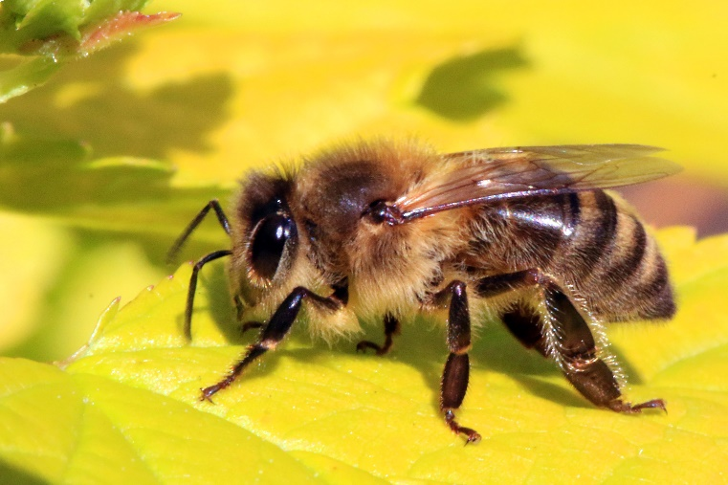
Honey Bees and Beekeeping Basics
Neely Harris
NCBA Volunteer
(Northern Colorado Beekeepers Association)

Slide 2
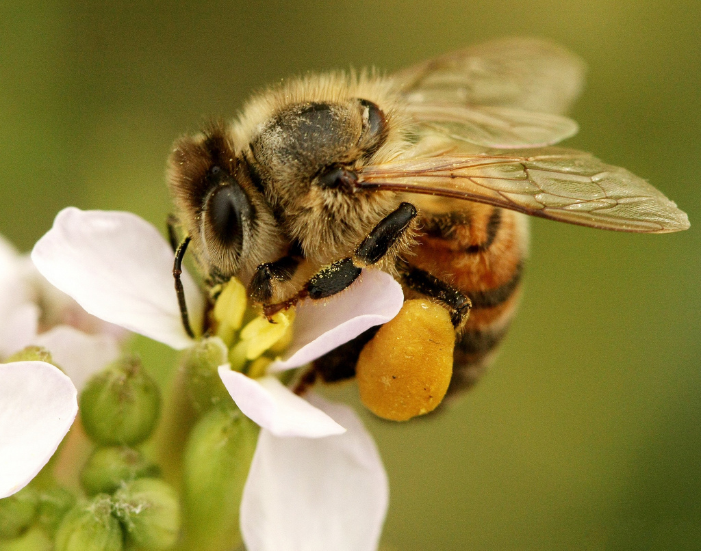
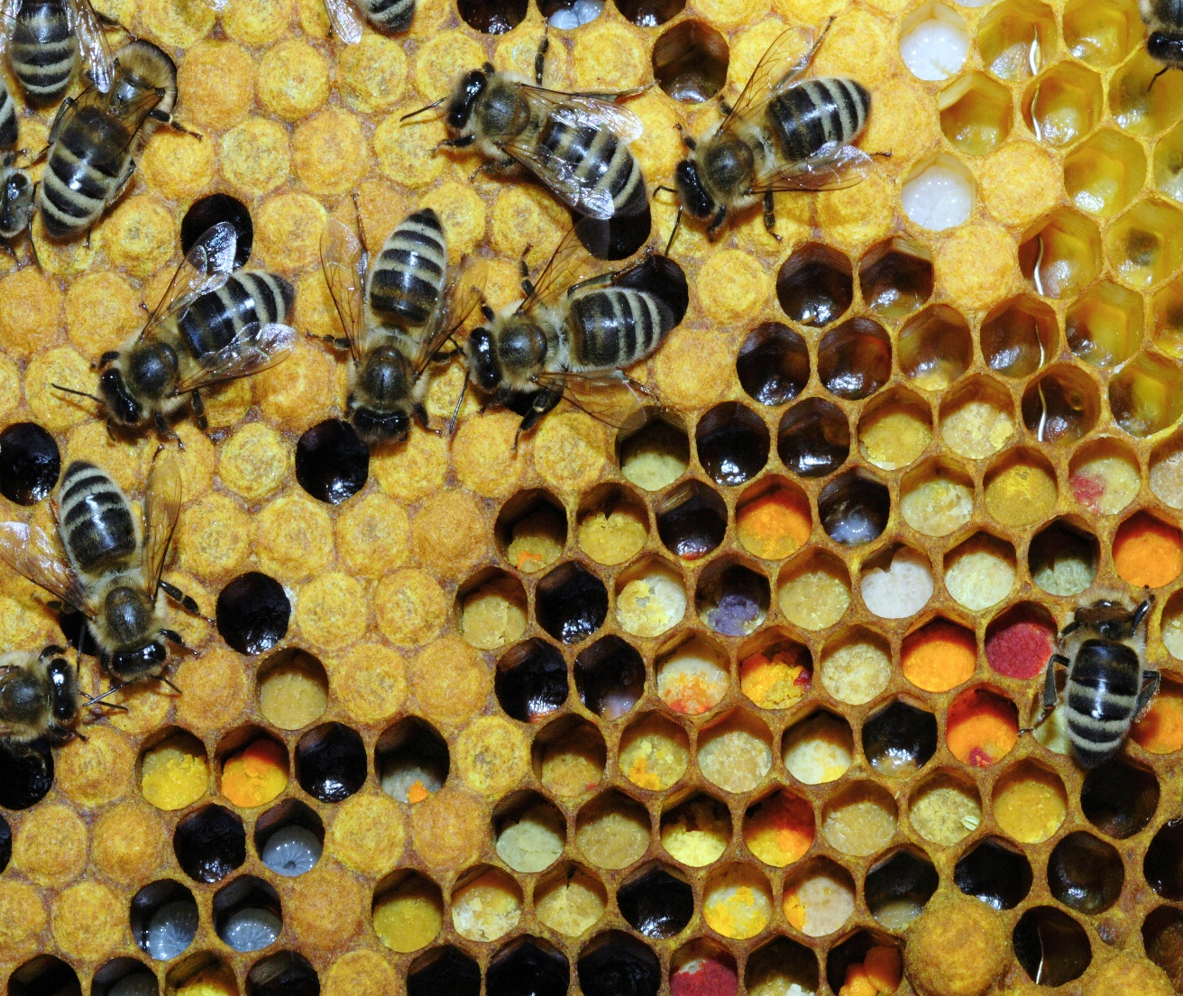
Bees collect Pollen and Nectar
This Photo by Unknown Author is licensed under CC BY-SA
This Photo by Unknown Author is licensed under CC BY-SA

Slide 3
Pollination

Slide 4
Honey Bees = LOTS of fruit!

Slide 5
Bee Anatomy (body parts)

Slide 6
The “Waggle” Dance

Slide 7
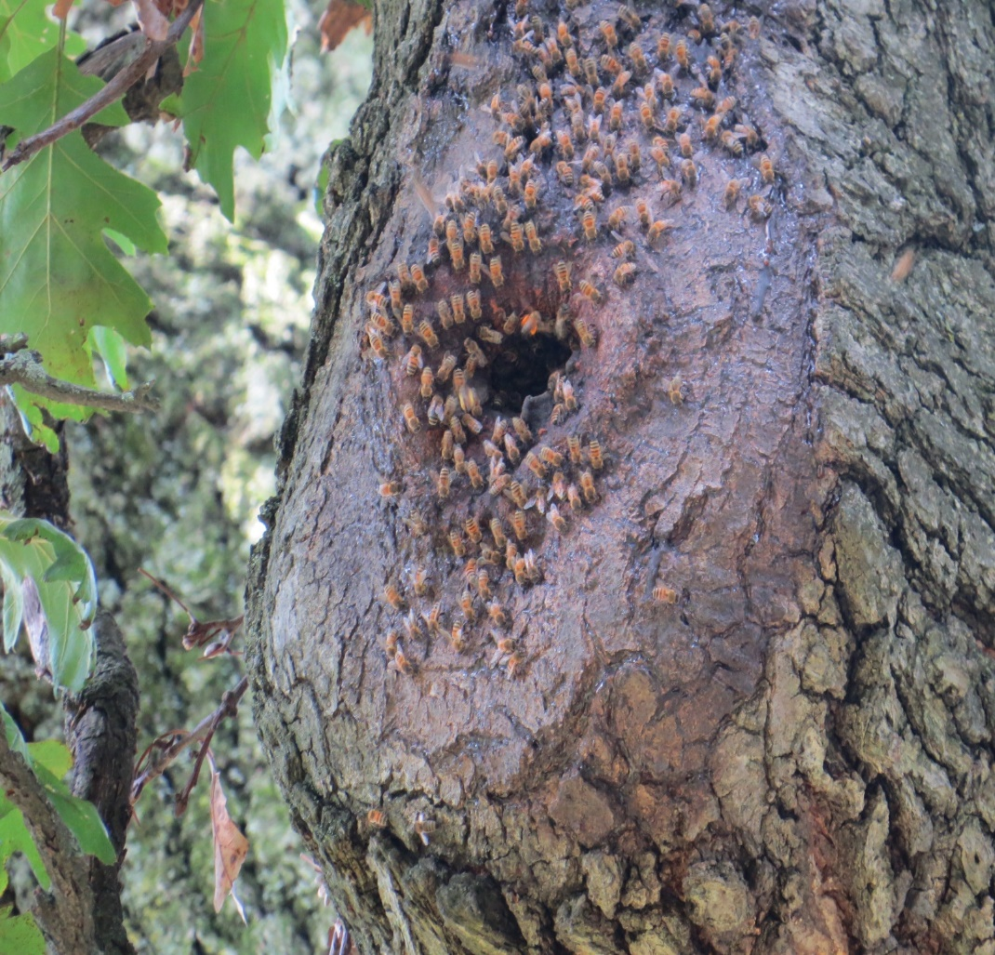
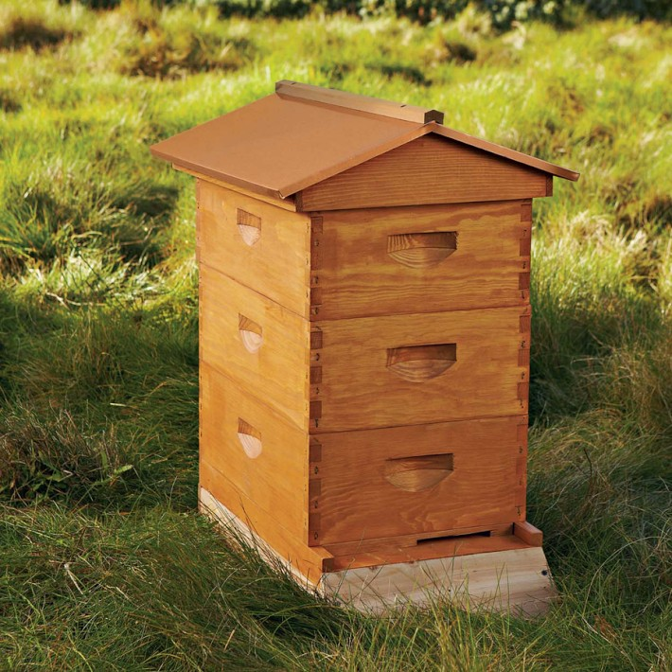
Bee Hives
This Photo by Unknown Author is licensed under CC BY-NC

Slide 8
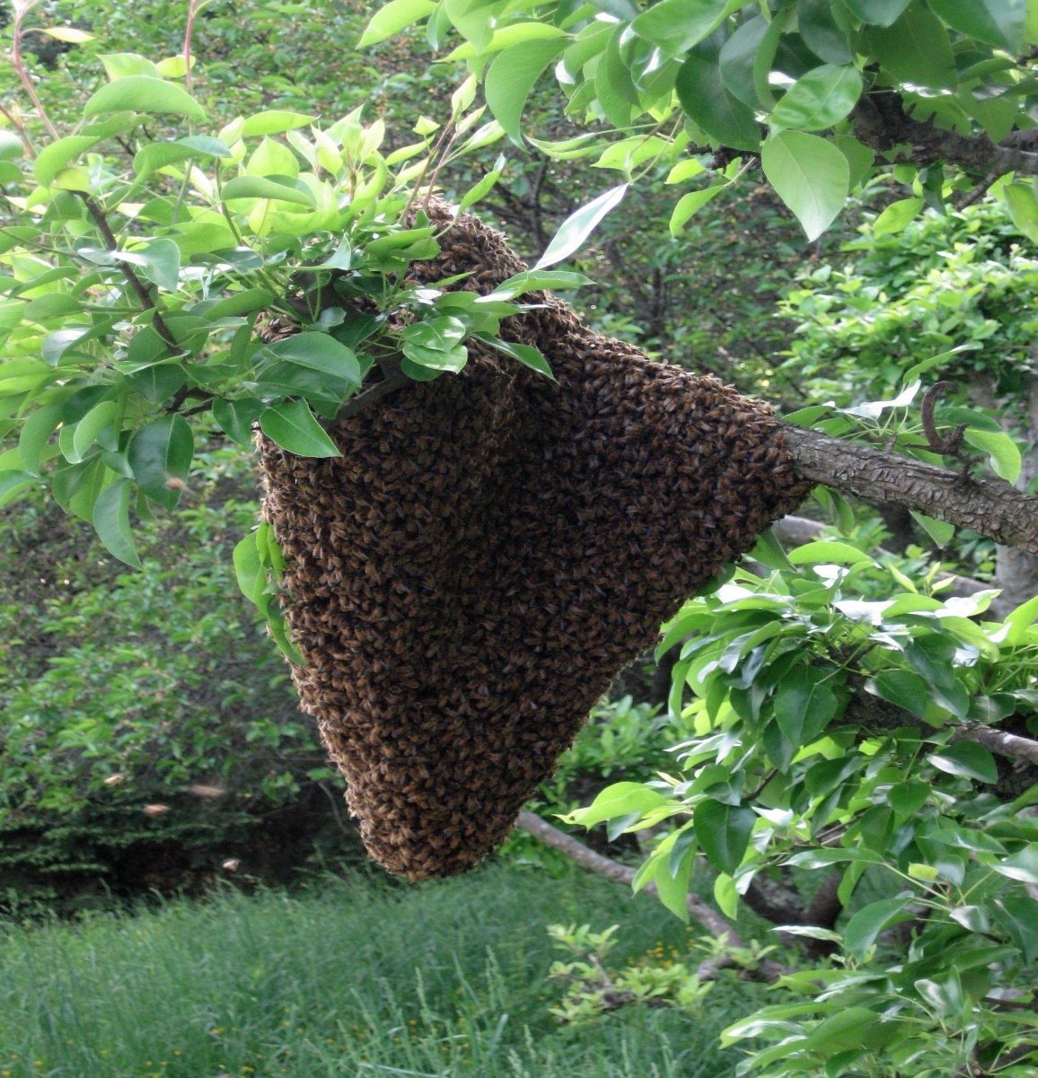
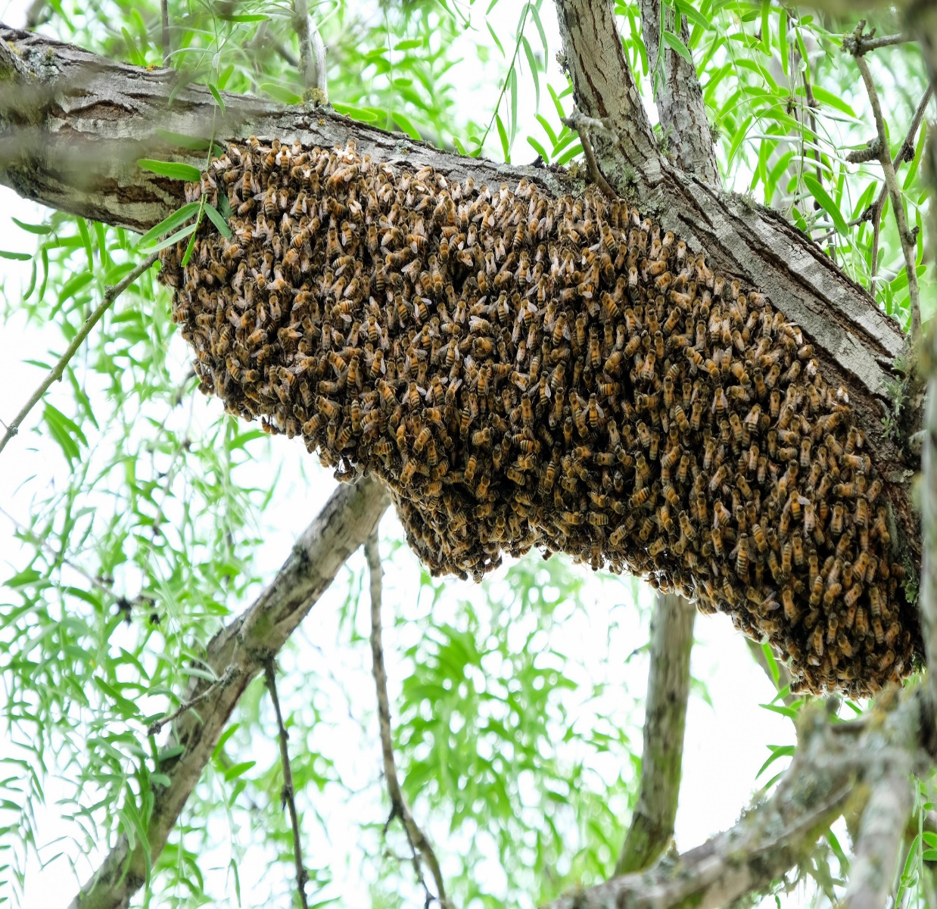
Bee SWARM (leave them alone!)

Slide 9
The Life Cycle of a Bee (video)

Slide 10
Worker Queen Drone

Slide 11
Can you spot the QUEEN?

Slide 12
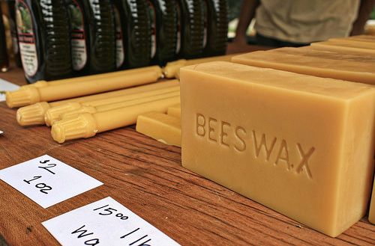
A Bee’s Gifts

Slide 13
Hexagonal Honeycomb

Slide 14
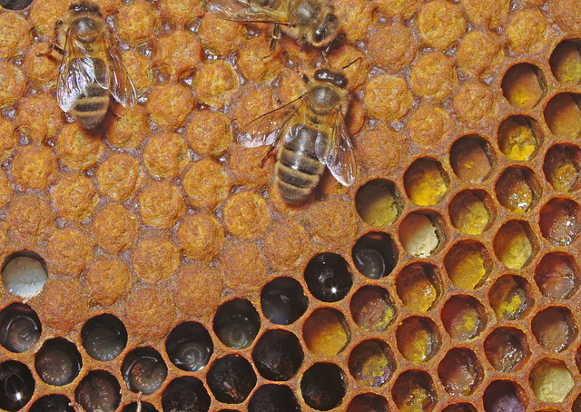
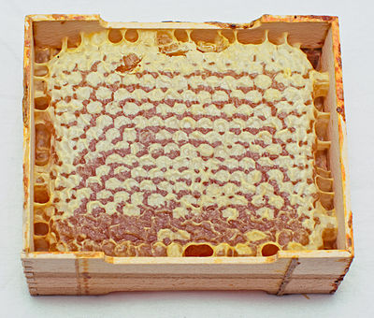
Comb with “Brood” Comb with capped honey
This Photo by Unknown Author is licensed under CC BY-SA-NC
This Photo by Unknown Author is licensed under CC BY-SA

Slide 15
Cold outside…nice and WARM inside!

Slide 16
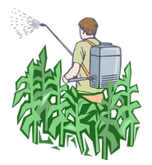
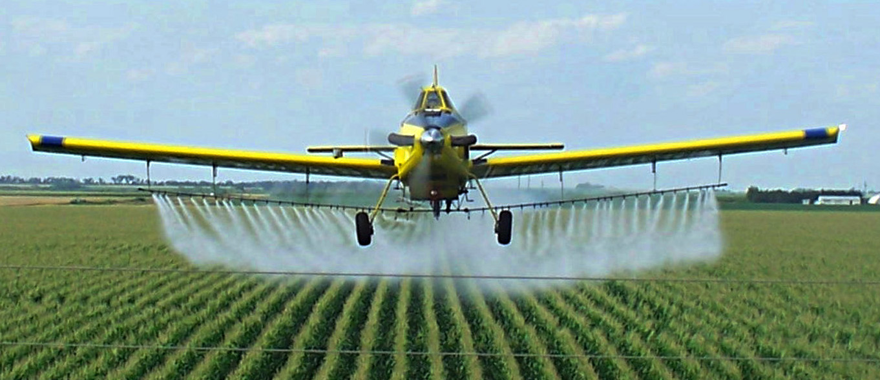
Insecticides and Pesticides kill bees

Slide 17
Varroa Mites (and other diseases) can kill too

Slide 18
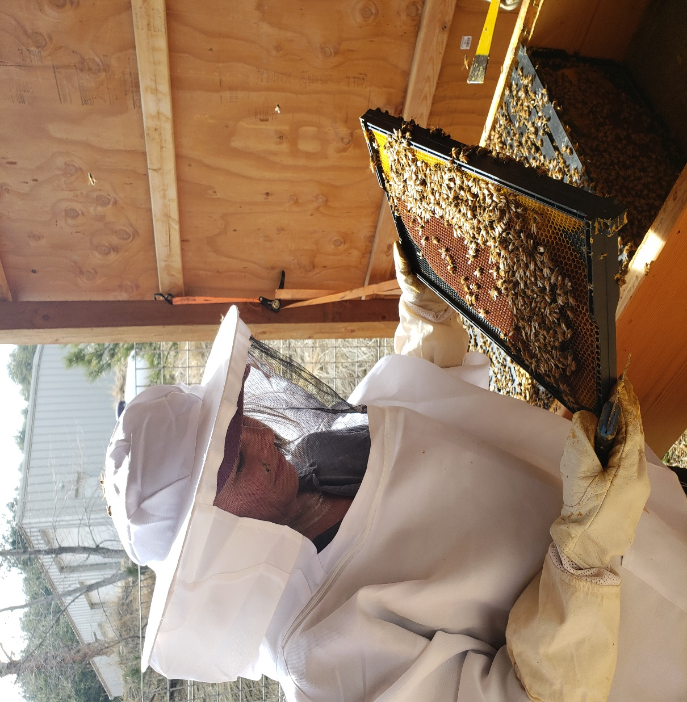
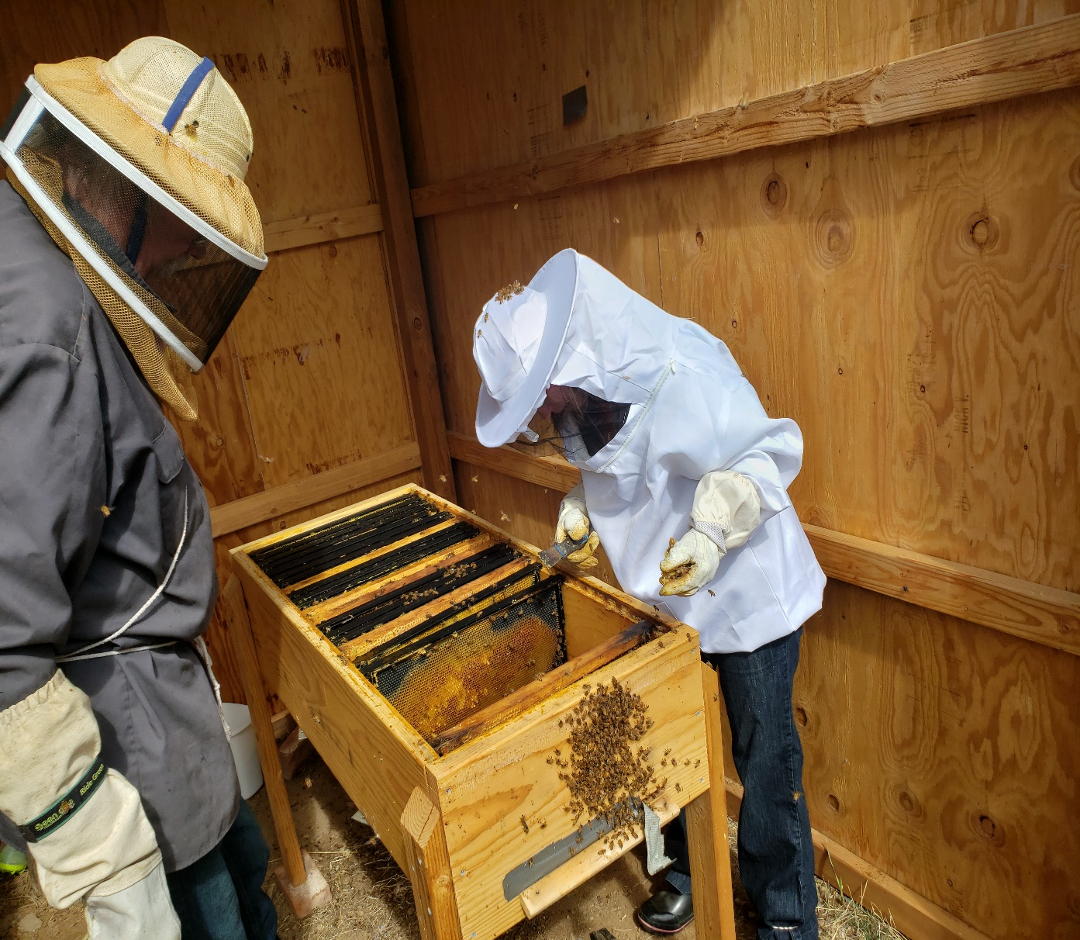
Wanna help? Become a BEEKEEPER!

Slide 19
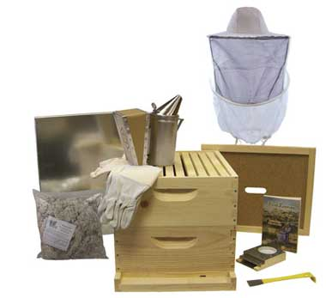
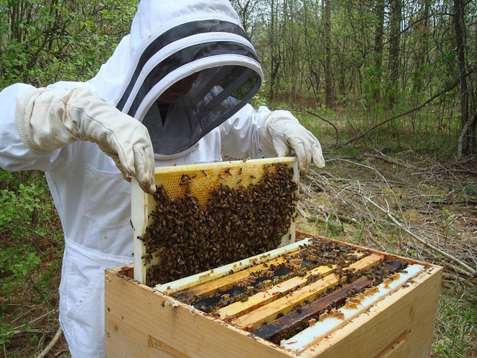
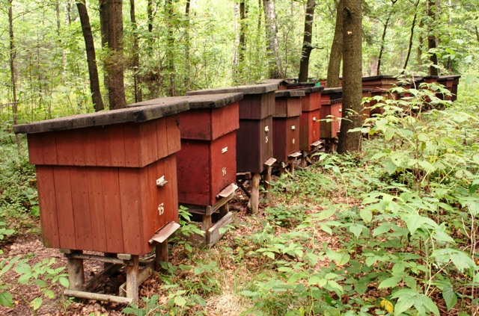
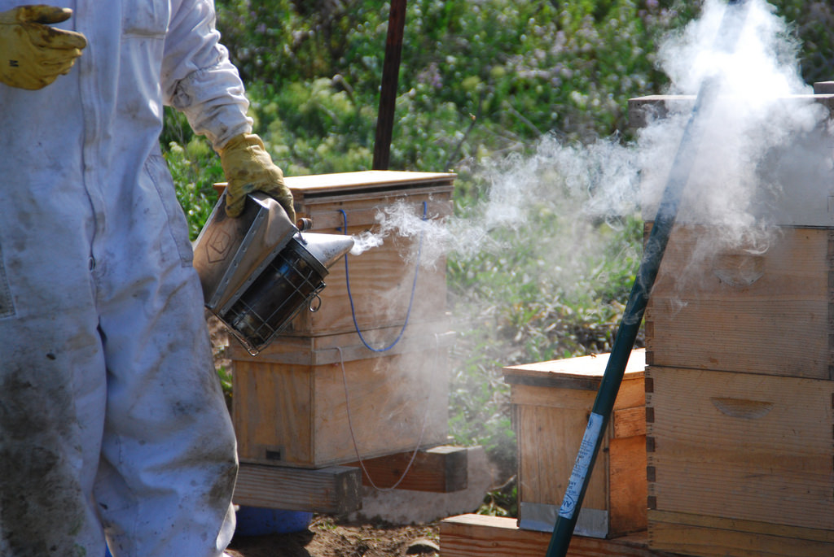
Beekeeping Supplies

Slide 20
~ YUMMY HONEY ~

Slide 21
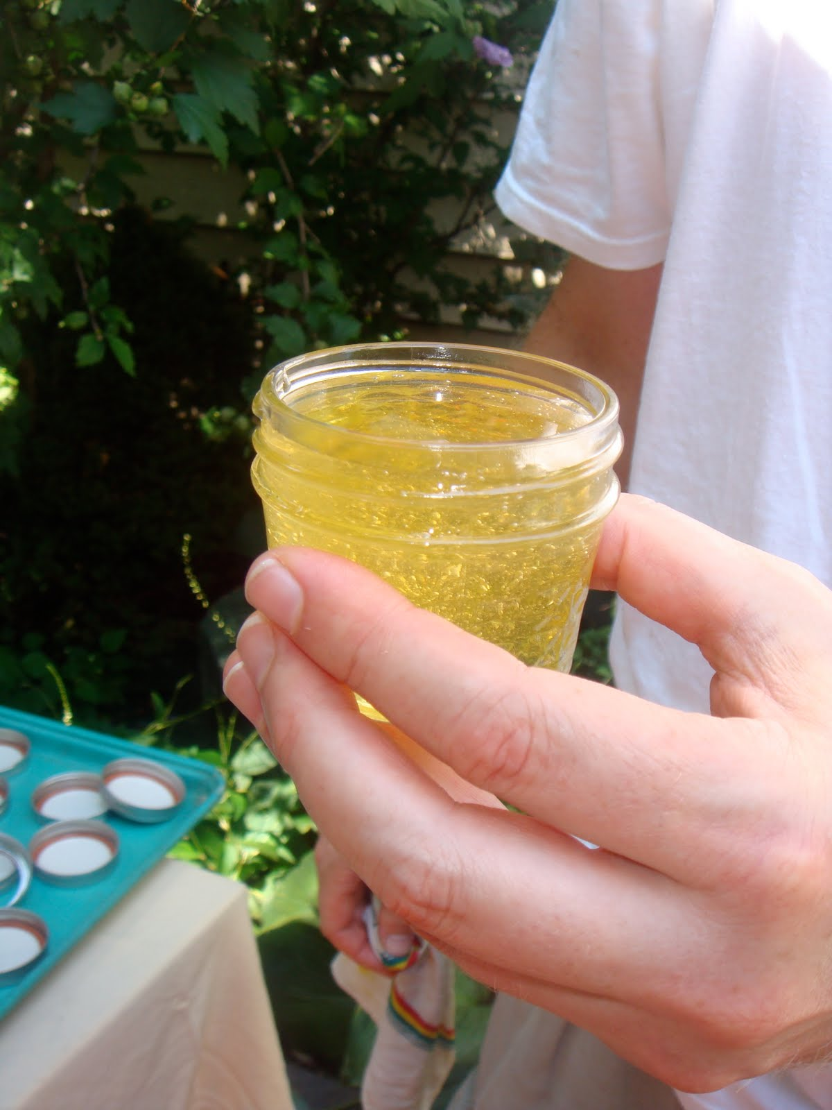
For the LOVE of Bees!
This Photo by Unknown Author is licensed under CC BY-NC

Slide 22
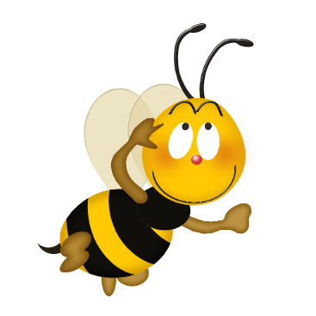
THE END

